Slide 1
How to access Six-Thinking-Hats.com

Slide 2
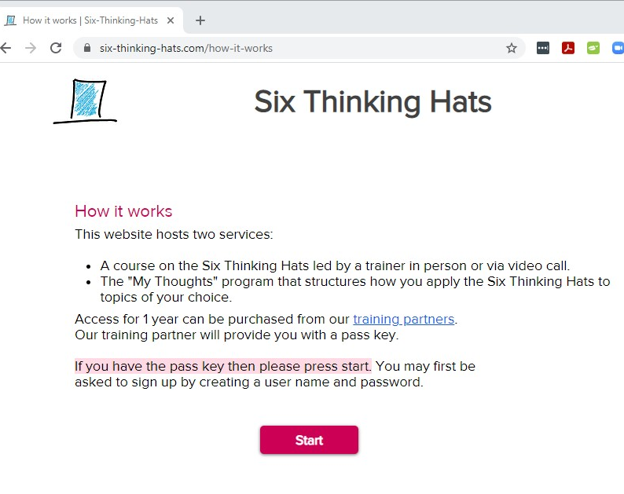
Go to
six-thinking-hats.com/how-it-works
Click Start

Slide 3
3. If this is your first visit, you will be asked to Sign Up.
Please use a password that is known only to you.
If this is a return visit you will be asked to Log In with the Email and Password you used to Sign Up, or the browser will remember you, and you will get immediate access to the course.

Slide 4
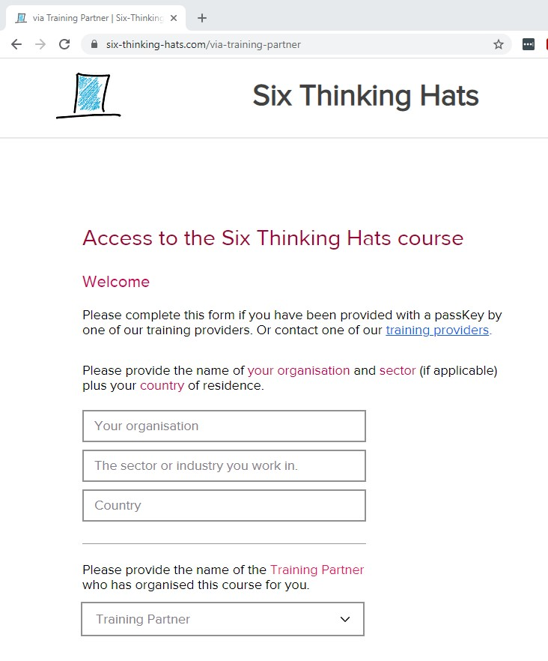
4. Please complete the form.
Select ADD NAME HERE
as The Training Partner
See the next slide

Slide 5
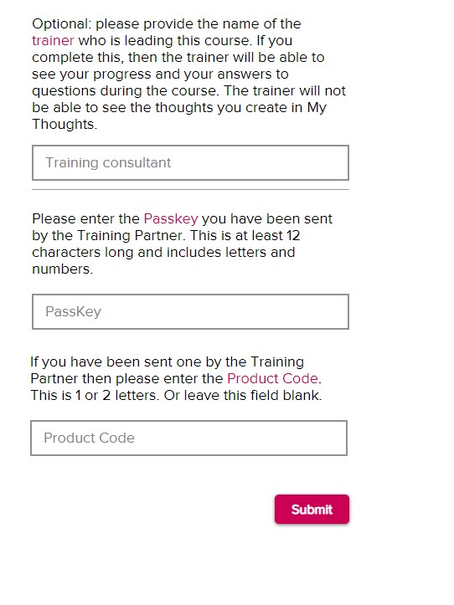
5. Continue completing the form
Training consultant ADD NAME HERE
Passkey ADD PASSKEY HERE
Product Code (leave this blank for the short course)

Slide 6
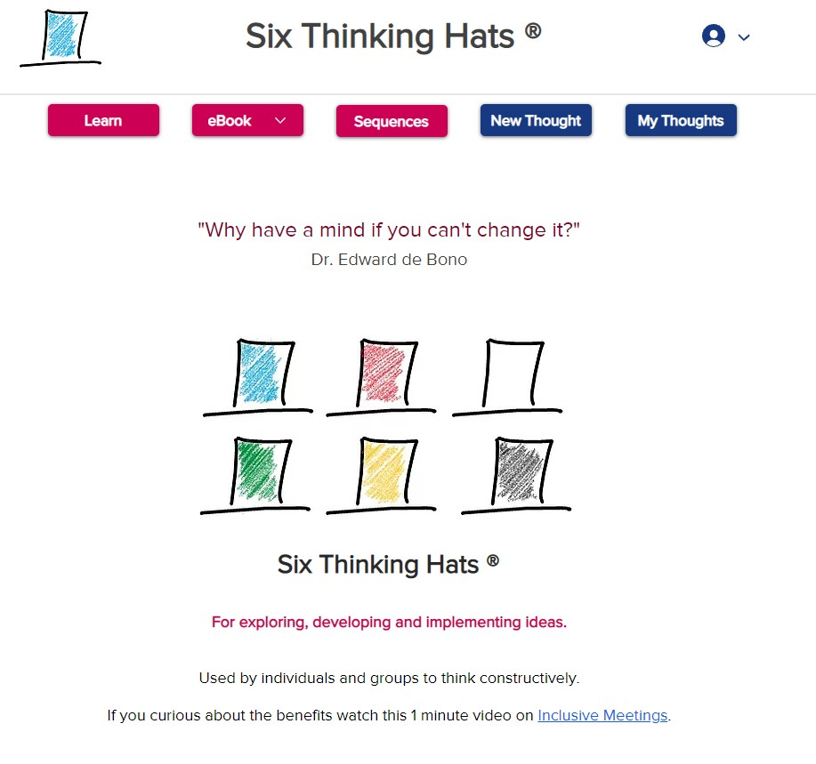
6. You will now have access to the Course.
The course is available as an interactive English language course accessed via the Learn button
six-thinking-hats.com/lesson-menu
Also in a variety of languages as an eBook via the eBook button

